Slide 1
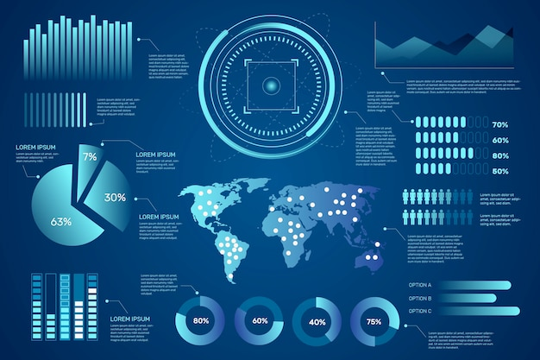

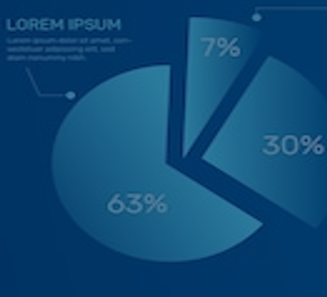
DSA5400
Visual Data Exploration
Module 2: Visualization and Cognition
Michael Dupin, Ph.D.

Slide 2
Module 02 - Preamble
What do you hope to gain from this visual data exploration class or how I can help you in particular?
1. Learn or improve coding skills, particularly in R and Python for data analysis and visualization (Mentioned by 6 people)
2. Gain proficiency in using Tableau for data visualization (Mentioned by 6 people)
3. Understand how to present and interpret data effectively through visualizations (Mentioned by 7 people)
4. Develop skills in data storytelling and effectively communicating insights from data (Mentioned by 5 people)
5. Learn specific visualization tools and techniques for different data types and scenarios (Mentioned by 3 people)
6. Gain hands-on experience with real-world datasets and practical application of skills (Mentioned by 2 people)
7. Ability to predict outcomes and identify trends using statistical analysis and visualization (Mentioned by 1 person)
8. Transfer skills learned in class to professional work settings (Mentioned by 4 people)
9. Understand how to work with small sample sizes and translate academic learning to work problems (Mentioned by 1 person)
10. Gain experience in creating more complex and aesthetically appealing visualizations (Mentioned by 2 people)

Slide 3
Module 02 - Preamble
**Coding Experience:**
- No experience in coding: 1 person
- Introductory level of experience: 4 people
- Introductory to intermediate level: 2 people
- Somewhere between beginner and intermediate: 1 person
- Intermediate skills in R: 1 person
- Slightly experienced (minor in Data Analytics and Computer Science): 1 person
- Solid programming experience primarily in R: 1 person
- Coding for a while, experienced in R and Python: 1 person
- Decent amount of experience with Python and R: 1 person
- Experienced programmer (full stack software developer): 1 person
- Experience level not specifically mentioned: 2 people
**Experience with Specific Languages and Tools:**
- Python:
- Familiar with Python: 2 people
- Decent amount of experience with Python: 1 person
- Some experience in Python: 3 people
- R:
- Solid experience primarily in R: 1 person
- Decent amount of experience with R: 1 person
- Comfortable with R: 1 person
- Feel confident about skills in R: 1 person
- Intermediate skills in R: 1 person
- Experience in R mentioned: 3 people
- Introductory experience in R: 1 person
- Tableau:
- Excited to learn Tableau: 5 people
- Beginner in Tableau: 1 person
- Some experience in Tableau: 1 person
- No experience with Tableau: 1 person
-
- SQL:
- Some experience in SQL: 1 person
- Beginner in SQL: 1 person
- Other Tools/Software:
- Experience with DataCamp (not specified which languages): 1 person
- Experience with ggplot2 R package: 1 person
- Experience with Seaborn and Pandas packages (Python): 1 person
- Experience using MSSQL and BigQuery: 1 person
- Experience with DAX: 1 person

Slide 4

Module 02 - Preamble
And the results are in!
9 votes (I didn’t add mine)
Thursday April 11th at 7PM is the (clear) winner.
!
!

Slide 5
Module 02 - Overview
Objectives
Illustrate how to turn data into a competitive advantage
Determine the data science workflow and where potential projects fall
Utilize key aspects of human perception and cognition to create useful visualizations
To-Do List
Review: materials linked on the content page
Complete: Assignment 02 - Position Paper 01
Attend: Class Session
Complete: This module's quiz: Module 02: Quiz 02
EDA | Data Viz | Assignments
Provost & Fawcett Ch. 2 Banasiewicz Ch. 3, 6 HBR - A Refresher on Statistical Significance | Yau Chapters 5-7 Cairo Chapters 5-7 Wickham Chapters 1-2 | Week 2 - Position Paper 1 (10%)

Slide 6
Course Roadmap & Assignments
Week 1 | Week 2 | Week 3 | Week 4 | Week 5 | Week 6 | Week 7 | Week 8
Course learning objectives Data, information, and knowledge Intro to data visualization | Data as a competitive advantage CRISP framework Human perception and cognition | Data science value chain Intro to ML Grammar of graphics | Data types ggplot2 (Grammar of graphics con’t) | EDA process Diagnosis and treatments Special cases: time, space, and clusters | Segmentation R Shiny | Segmentation and profiling Tableau and other dashboards | Course wrap-up Tableau
Introduction | Position Paper #1 | Position Paper #2 | Data Due Diligence Project |  | Segmentation and Profiling Project
Quiz 01 | Quiz 02 | Quiz 03 | Quiz 04 | Quiz 05 | Quiz 06 | Quiz 07 | Quiz 08

Slide 7
Position Paper #1 Overview
Consider the continuum of data—information—knowledge.
When you think about the task of translating data into information and the task of extracting meaningful knowledge out of information:
What do you see as the key organizational, data, and use case challenges associated with those tasks? (Please choose three examples)
What are potential solutions to these challenges?
Be explicit (i.e., fully explain and justify your points) in your explanation. Use and cite resources!
Format: No more than 2 single-spaced page in PDFed Word | Calibri, 10-pt font throughout, cite your work.
Avoid monolithic essays: use formatting, sections, illustrations if applicable, etc.

Slide 8

Position Paper 1 Hint - Data – Knowledge Continuum
Data has potential value and competitive advantage proportional to its …
Availability
Quality
Ability and relevance to inform key business decisions
Skills of data engineers and data scientists
Knowledge
Actionable Insights / Productionized systems
Information
Summarized / Synthesized / Joined Data
Data
Raw Data or System of Record

Slide 9
Turning Data to Competitive Advantage –
Where Data Mining / Data Exploratory Analysis (EDA) Fits

Slide 10

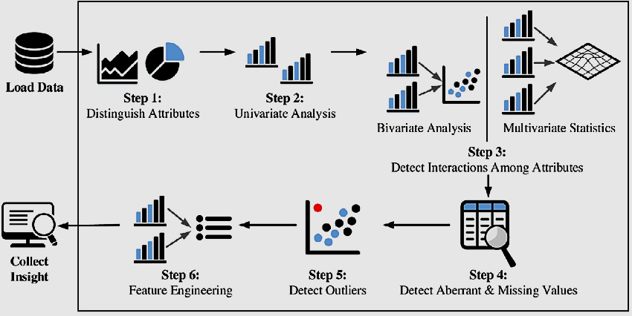
Data Mining Process – A General Overview
Data mining is a craft involves art and science with a well-established process that places a structure on business problem, allowing consistency, repeatability and objectiveness … that can turn data to competitive advantage.
Cross-Industry Standard Process for Data Mining
(CRISP – DM)
Data Science Value Chain
1
2
1
3
6
4
5

Slide 11
Who Does What in the CRISP-DM Framework?
Activity | Team
1. Business Understanding | Business users / Stakeholder / Sponsors Analytic consultant
2. Data understanding | Data analysts with inputs from business users Analytic consultant
3. Data preparation | Data analyst and data scientist Analytic consultant
4. Modeling & roadmap | Data scientist: model development Analytic consultant with business user inputs: roadmap development
5. Evaluation | Data scientist: model evaluation Analytic consultant with inputs from Business user: business case evaluation
6. Deployment | Data scientist / data analyst Analytic consultant Marketing technology - data engineering / developer
Team Continuum - Designed to achieve shared understanding of business challenges and goals, as well as deliver stated objectives
Business users think of achieving business goals such as targeting and retaining most valuable customers
Analytic consultant / Data scientist / Data Analyst gather requirements, assess data sources, translate business objectives to quantifiable and measurement solutions:
Analytic consultant - often project manager, client facing
Data analyst – often supports analytic consultant, works with data but don’t build models
Data scientist – model development, tech and coding heavy

Slide 12
Illustrative Activities Across CRISP / Data Science Value Chain
1. Business Understanding | Discuss business goals with key stakeholders Translate goals into business questions that are quantifiable and measurable Manage expectations
2. Data understanding | Data ingestion from multiple data sources Data storage, access, and security Database and IT architecture, secure workspaces Metadata
3. Data preparation | Siloed data, different data formats and data types Data access, roll-up, merge and join, synthesize Data access architecture Data preparation for analysis and modeling
4. Modeling & roadmap | Business focused model development, ideation, and brainstorm Descriptive, diagnostics, predictive and prescriptive analysis Define problem and model choices – profiling, segmentation, classification/regression Analytic roadmaps
5. Evaluation | Model evaluation – out of sample/out of time validation, R squared, ROC, confusion matrix, cross-validation, etc. Business case evaluation Value and prioritization of multiple business cases
6. Deployment | Deployment, Productionisation and automation Test and measurement planning and execution, including on-going reporting Package insights and recommendations for client deliverables and interfaces User requirement, access rules and training
1
1
2
3
6
4
5

Slide 13
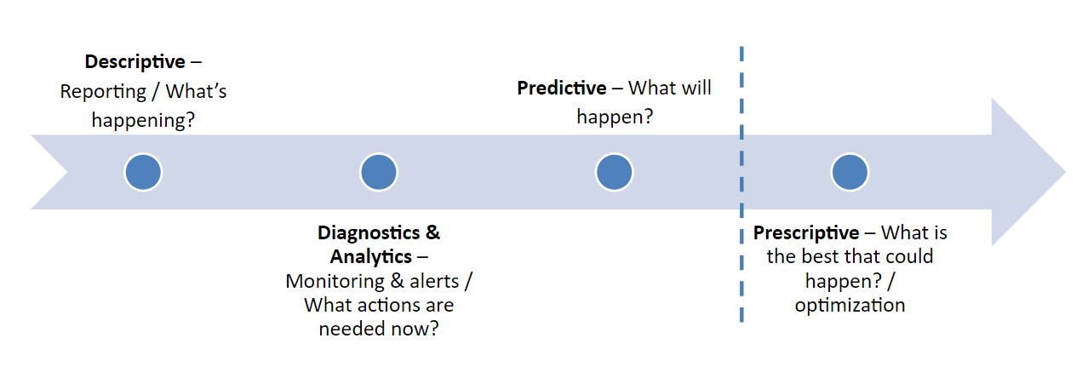
Not Every Project Requires Modeling
Understand your application and use case
Data requirements
User requirements
Type of analytics
Use the simplest tool available to accomplish your project
1
1
2
Examples
Reporting vs prediction
Visualizations vs tables
Regular expressions vs NLP/LLM
Linear models vs Neural Nets
3
6
4
5

Slide 14
Data and Data Science
Get a lay of the data land you have for your project….
Data Scientists Abilities and What’s Possible …
Data Lake, Data Warehouse, Lakehouse, etc ?
Data
Data and Databases ?
Data Model ?
Data Content ?
Reporting
Summarizing & relating of facts
Inferential Knowledge
Probabilistic explaining & predicting
Structured vs.
Unstructured Data ?
Single vs. Multi- source Analytics ?
Directed Analytics
Strategy-driven hypothesis testing
Data Mining
Open-ended relationship detection
On prem/Cloud/Hybrid ?
Data Types ?
Think about what you can do with what you have
Think about what you need for what you want.
Transactions campaign results survey opinions
Focus groups interviews videos
Quantitative & Root | Qualitative & Root
Quantitative & Derived | Qualitative & Derived
Propensities sales aggregates geo-demographics
Emerging themes observational interpretations

Slide 15
Types of Information Graphics
Know your Audience: Figurative to Abstract

Slide 16
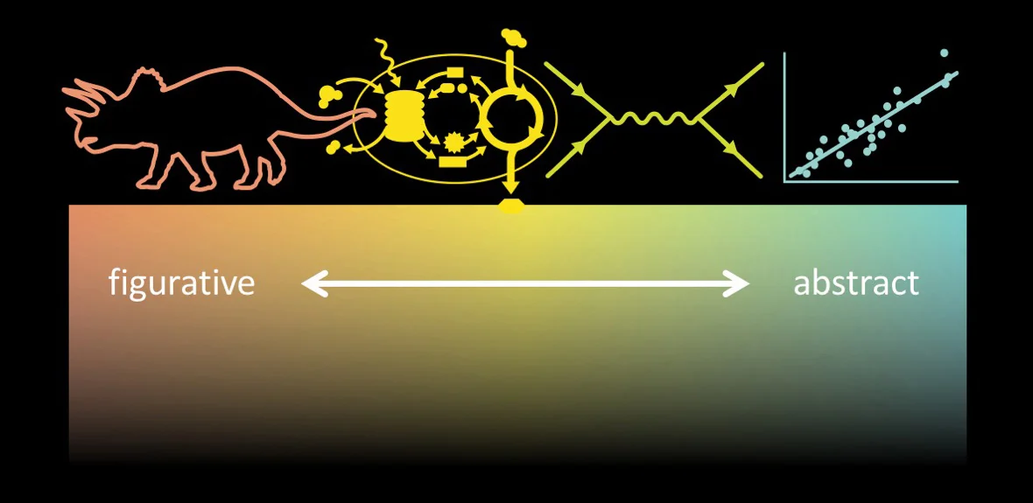


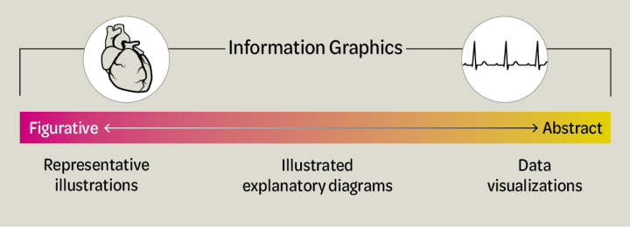


Information Graphics in General
Data Visualizations are a type of information graphic representing only an abstraction of the environment we are studying.
This means we have a challenge to choose the types of plots, aesthetics (colors, emphasis, style, and markers) and transformations of raw data to tell our story!
Christiansen, Jen. Building Science Graphics.

Slide 17

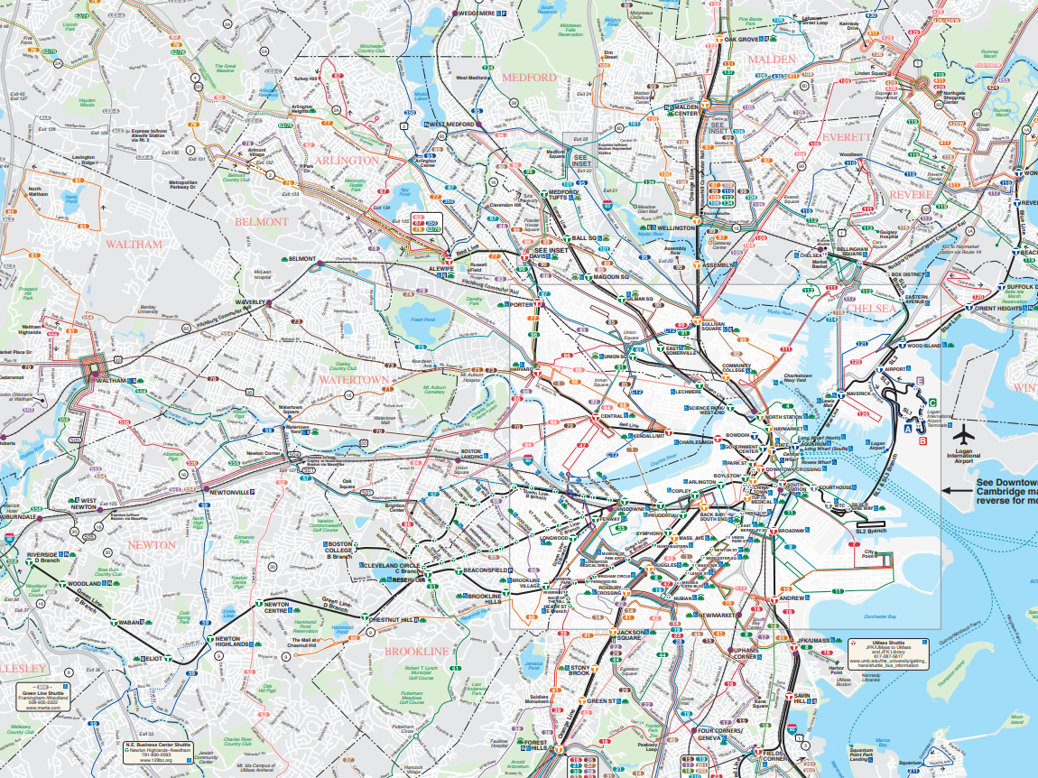
Representative Illustrations: Highest Level of Information
How do we go from Oak Grove to Riverside using the T?
MBTA Lines - Maps (https://www.mbta.com/maps)

Slide 18
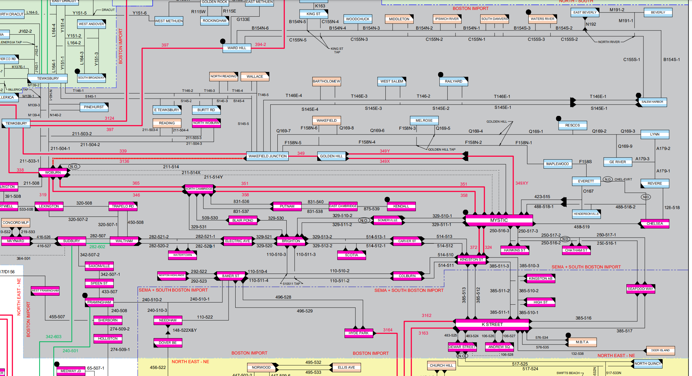
Illustrated Explanatory Diagrams
Where does Cambridge get its electricity from and what kind of redundancy are there?
New England Power Grid near Andover/North Andover (https://www.iso-ne.com/about/key-stats/maps-and-diagrams/#system-diagram)

Slide 19
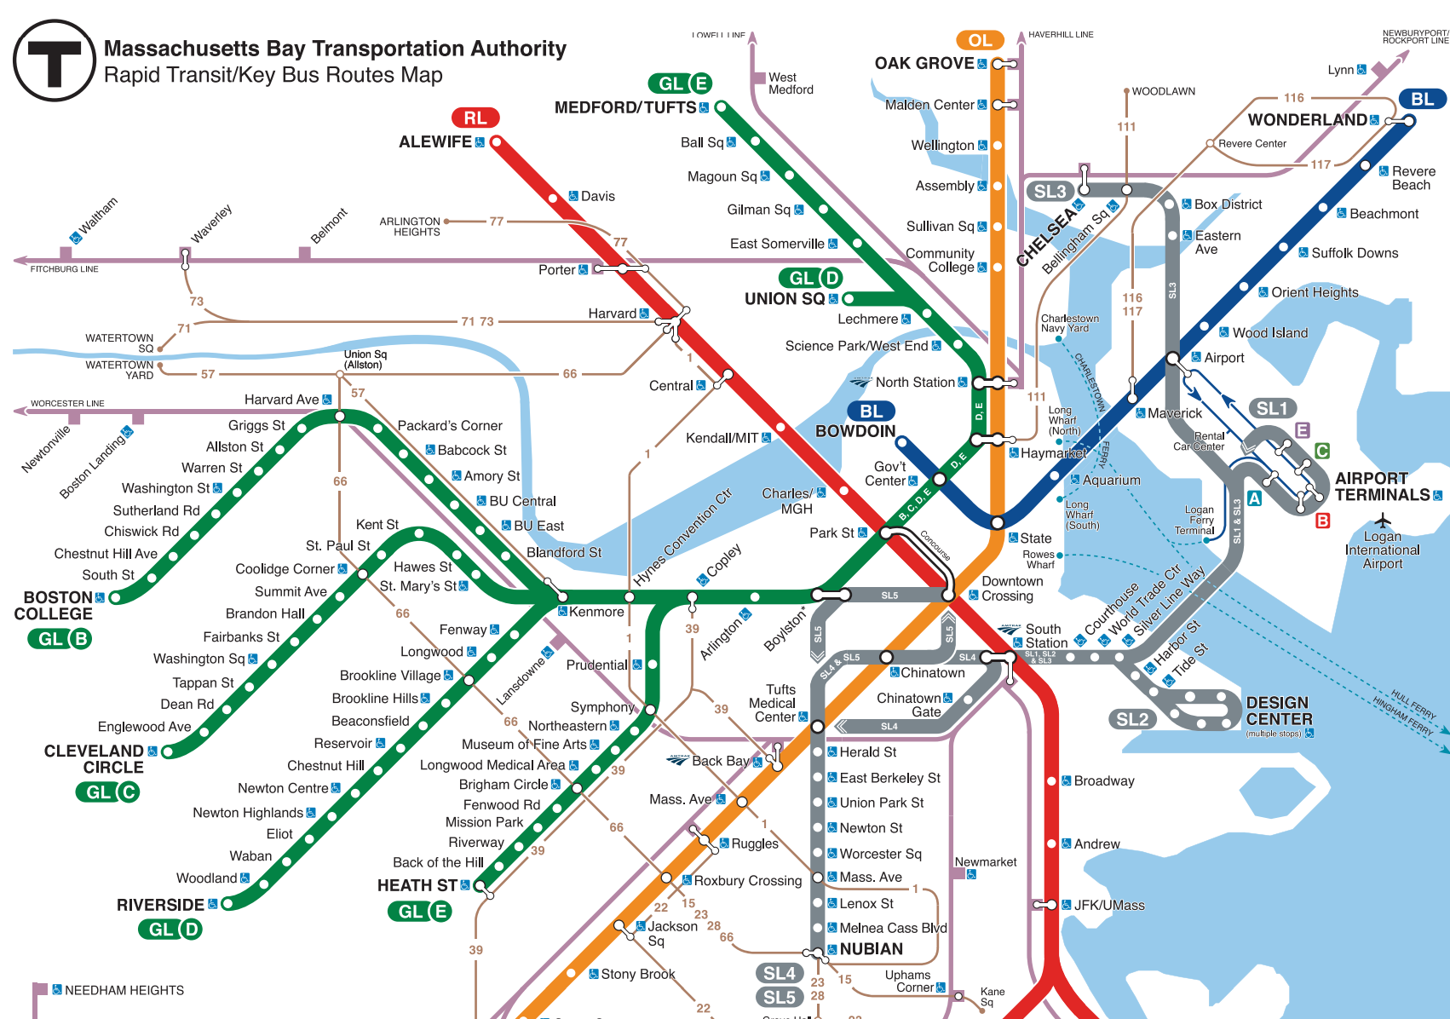
Illustrated Explanatory Diagrams: Focus on T Lines
How do we go from Oak Grove to Riverside using the T?
MBTA Lines - Stylized (https://www.mbta.com/maps)

Slide 20
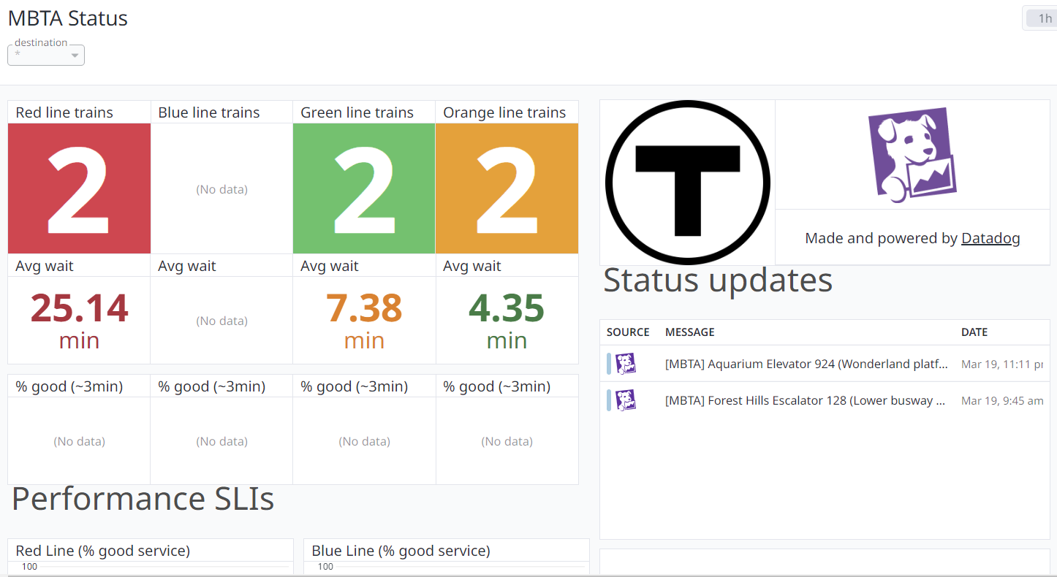
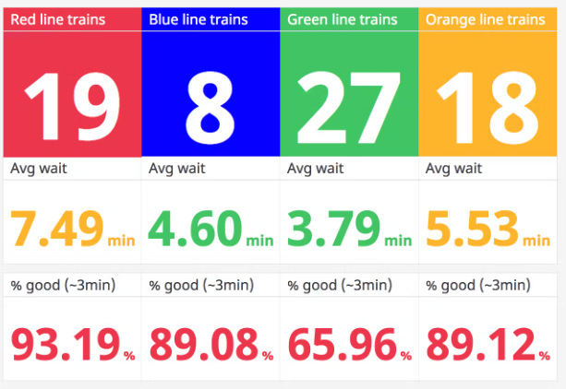
Data Visualizations
MBTA Status Dashboard (https://www.datadoghq.com/blog/monitor-mbta-status/)

Slide 21
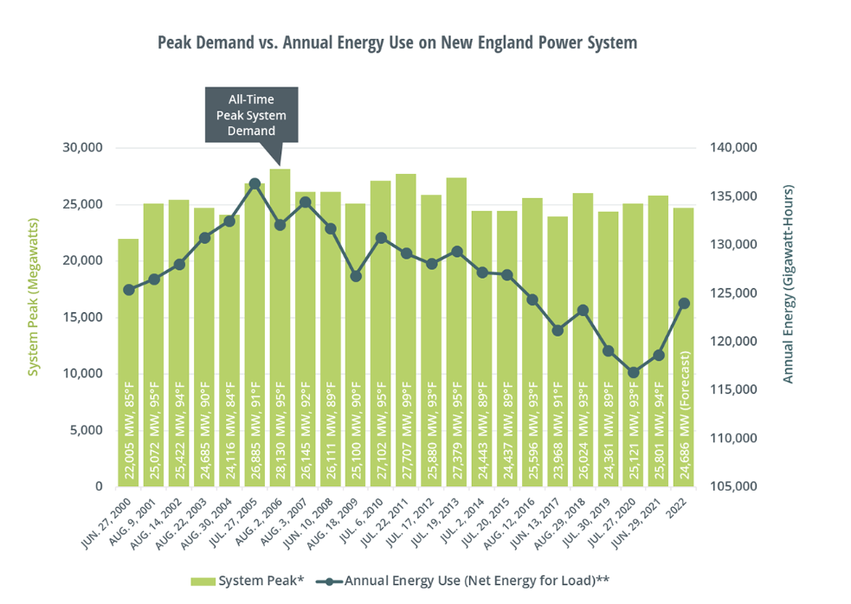
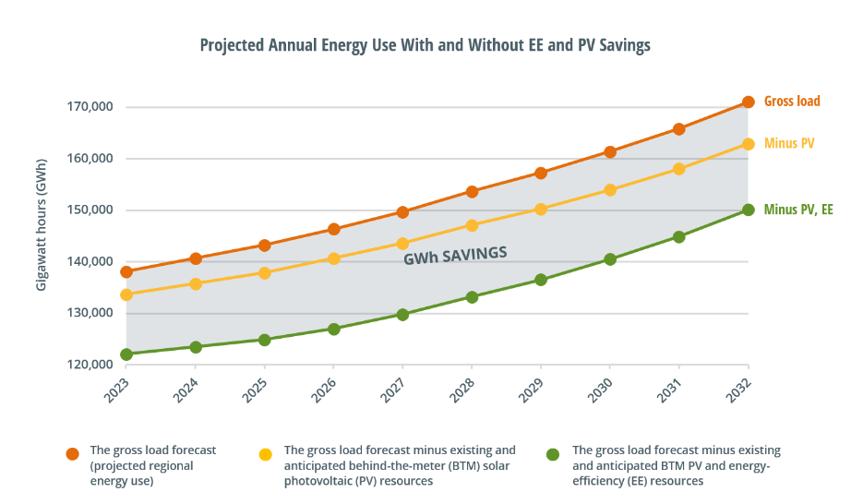
Data Visualizations
New England ElectriciSDty Use (https://www.iso-ne.com/about/key-stats/electricity-use)

Slide 22
Visualizations and Human Cognition
How do we SEE visualizations?

Slide 23





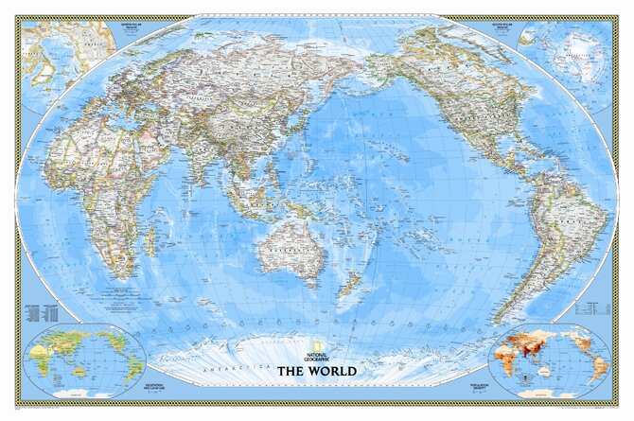



Five Ideas to Know
We see first what stands out.
In the grand tapestry of slide-based communication, the convergence of bullet points and clip art dances like shadows at dusk, painting a picture far broader than the canvas it's bestowed upon. Yet, within this opulent display, a singular truth persists with the tenacity of a footnote in a forgotten tome: our faculties, though eager, grasp only the slivers of a feast laid before them. As we navigate this labyrinth of insights and revelations, adorned with the finery of graphs in vibrant hues and tables arrayed like jewels in a crown, we stumble upon the realization that in our quest for enlightenment, the abundance of our offerings may well eclipse the core of our intentions. Through this journey, marked by the stepping stones of overzealous embellishments and the occasional oasis of clarity, we are reminded of the delicate dance between the said and the perceived, where the essence of our message risks being ensnared in the very web we weave. Let this be a testament to the art of simplicity, where the truest connections are forged not in the multitude of words, but in the spaces left for contemplation within the tapestry we so ardently compose. In other words, we see only a few things at once.
We seek meaning and make connections
We don’t necessarily go in order
We rely on conventions and metaphors

Slide 24
1. We don’t necessarily go in order like reading a page
3
4
Visuals aren’t processed linearly, there is not always a clear progression.
We should create charts that make sense spatially.
The central visualization is key
All other details (context, added information) should sit on the periphery
2
1
5
6
7
Good Charts by Scott Berinato

Slide 25
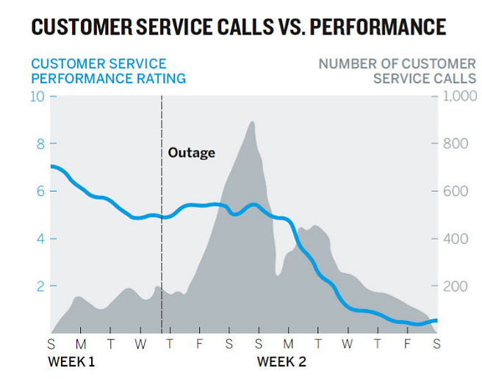
2. We see first what stands out
**** What are the first three attributes/characteristics you see in this picture? ****
We naturally gravitate towards contrasts, differences, and gaps.
The story should be told with what stands out. If you highlight something, that’s what people will remember.
Work to explain any outliers if they don’t support your theme.
Outage
Good Charts by Scott Berinato

Slide 26
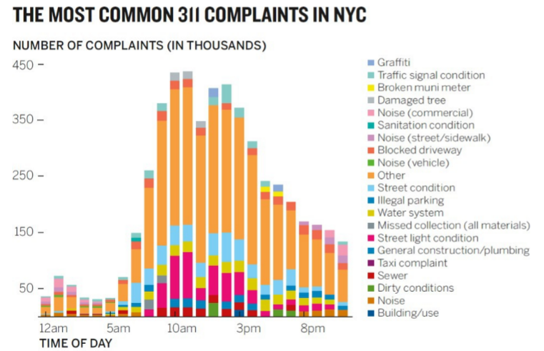
3. We see only a few things at once
A visual that plots thousands of data points can tell too many stories (or reach the wrong conclusion).
Plot the points you need (3-5 categories is a good rule of thumb)
Avoid presenting many different datasets in the same chart
Good Charts by Scott Berinato

Slide 27
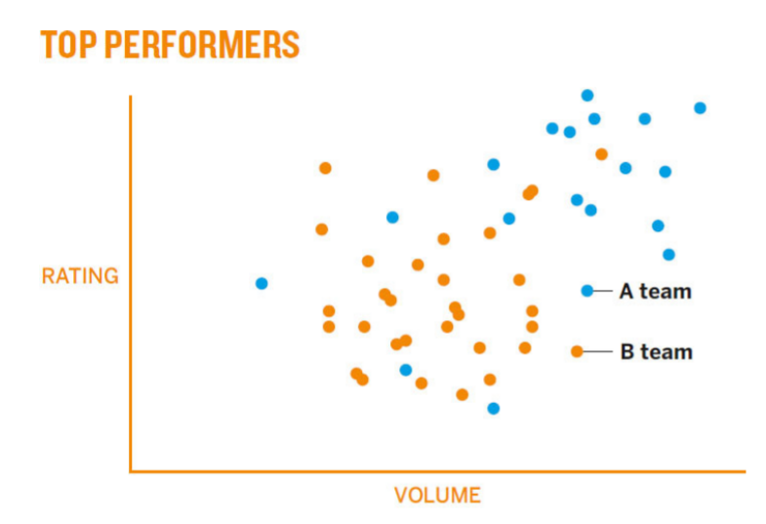
4. We seek meaning and make connections
We will inevitably try to establish connections between pieces of the chart.
Be careful with font, color, width - similar color mean similar items
Avoid presenting many different datasets in the same chart
Good Charts by Scott Berinato

Slide 28
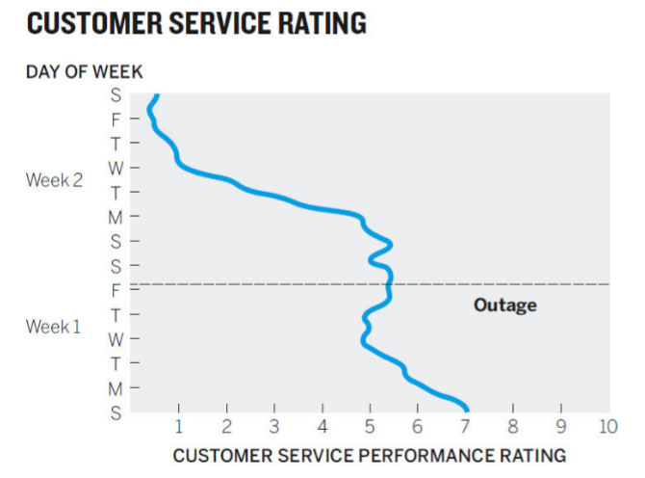
5. We rely on conventions and metaphors
What items are confusing here?
Challenging conventions will frustrate your viewers. Try to account for conventions as much as possible.
Avoid switching conventions (red = loss, green = gain), time, direction of north/south/east/west
Be consistent with your other visuals
Good Charts by Scott Berinato

Slide 29
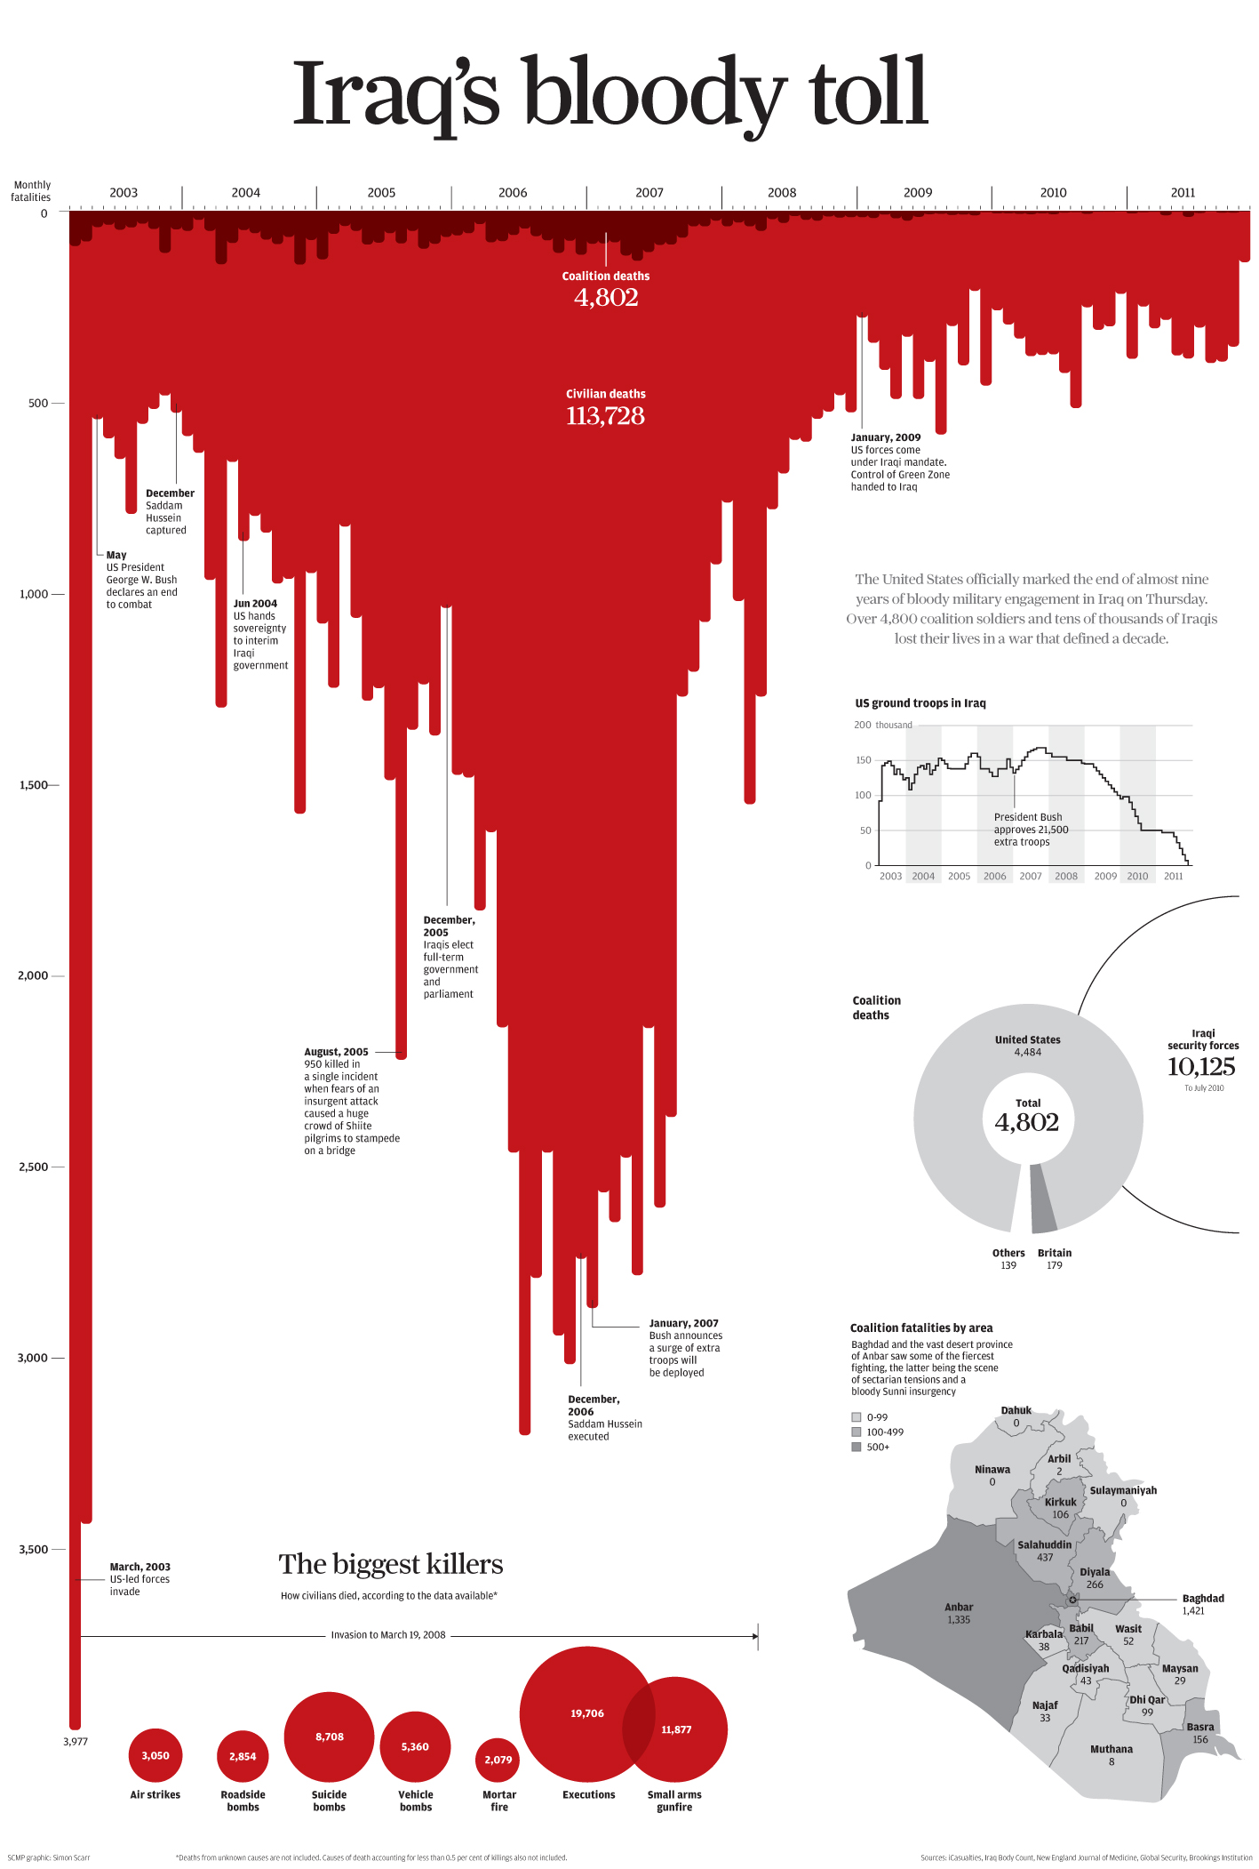
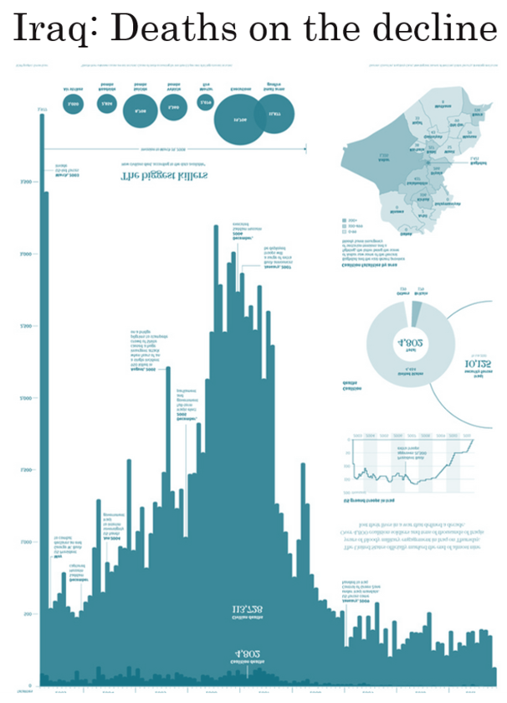
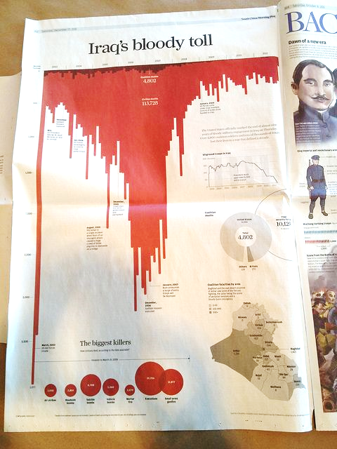


The Power of Illusion/Illustration

Slide 30

Live Programming
Let’s go!

